Slide 1

Introduction to
Edited by
Prof. Noha El-Attar
Head of Bioinformatics Dep.

Slide 2

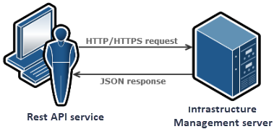

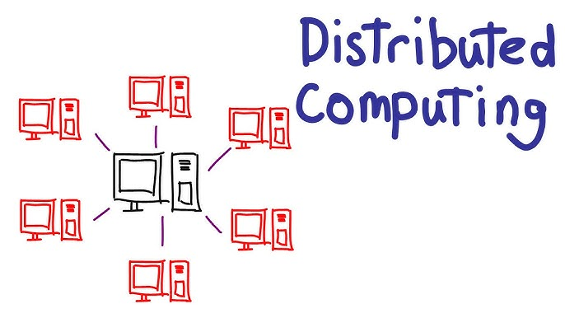
Do you remind
What is the mean of Big Data?
Big data refers to data collections that are too massive or complicated for typical data-processing application software to handle.
Disk and memory space
processing speed
hardware faults
network capacity
and optimizing resources use
Problems

Slide 3
Distributed Computing
A distributed computer system consists of several interconnected nodes.
Nodes can be physical or virtual machines.
This group of nodes provides services and applications to the client as if it were a single machine,
This is also called a cluster.

Slide 4
Main benefits of distributed computing
  Performance: supports intensive workloads by spreading tasks across nodes
  Scalability: new nodes can be added to increase capacity
  Fault tolerance: resilience in case of hardware failures

Slide 5

Distributed Computing Architecture

Slide 6
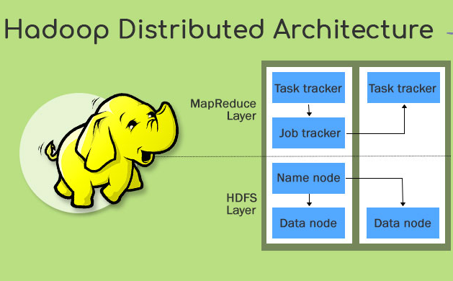
Hadoop for distributed data processing
Hadoop is a framework for running jobs on clusters of computers that provides a good abstraction of the underlying hardware and software.

Slide 7
Hadoop Features
Hadoop is an open-source project of the Apache Software Foundation.
The project was created to facilitate computations involving massive amounts of data.
Its core components are implemented in Java initially released in 2004.
Last stable version is 3.4.2 from August 2025 originally inspired by Google‘s MapReduce and the proprietary GFS
(Google File System)

Slide 8
Hadoop Features
Hadoop’s features addressing the challenges of Big Data:
  Scalability
  Fault tolerance
  High availability
  Distributed cache/data locality
  Cost-effectiveness as it does not need high-end hardware
  Provides a good abstraction of the underlying hardware
  Easy to learn
  Data can be queried trough sql-like endpoints (hive, cassandra)

Slide 9
Important Features in Hadoop
fault tolerance: the ability to withstand hardware or network failures (also: resilience)
high availability: this refers to the system minimizing downtimes by eliminating single points of failure
data locality: tasks are run on the node where data are located, in order to reduce the cost of moving data around

Slide 10
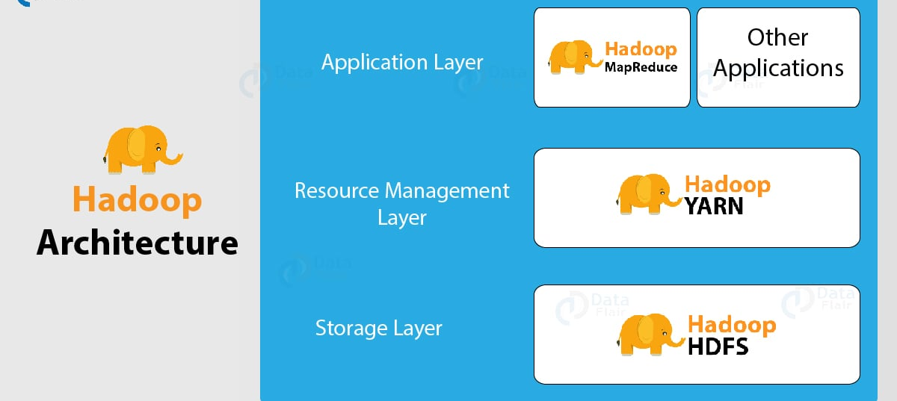
Hadoop Ecosystem
The core of Hadoop consists of:
  Hadoop common, the core libraries
  HDFS, the Hadoop Distributed File System
  MapReduce
  YARN (Yet Another Resource Negotiator) resource manager

Slide 11
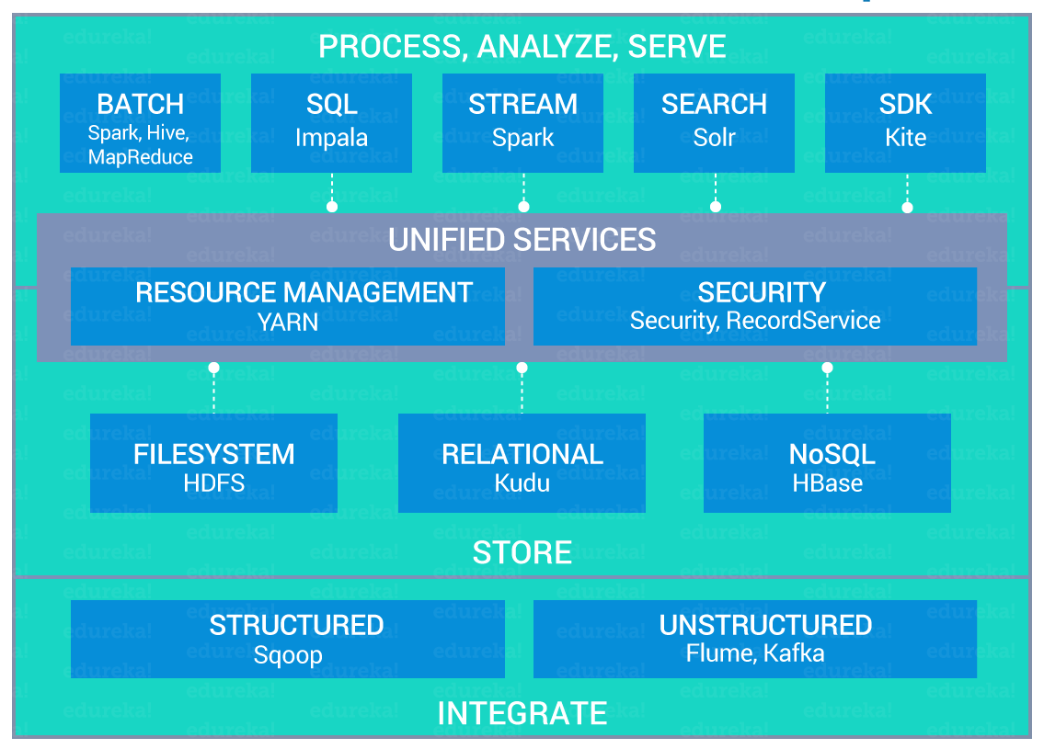
Hadoop Ecosystem

Slide 12
1. Data Integration
Sqoop vs Flume
Hadoop ETL(extract, transform, and load data) Tools
Apache Sqoop | Apache Flume
Apache Sqoop is a tool used to transfer large amounts of data between Apache Hadoop and structured data stores such as relational databases, data warehouses, and NoSQL data stores. | Flume is a distributed, reliable, and available service for collecting, aggregating, and moving large amounts of log data. It has a simple and flexible architecture for streaming data flows (unstructured data). Flume supports a wide range of data sources, including web servers, messaging systems, log files, and social media feeds.

Slide 13
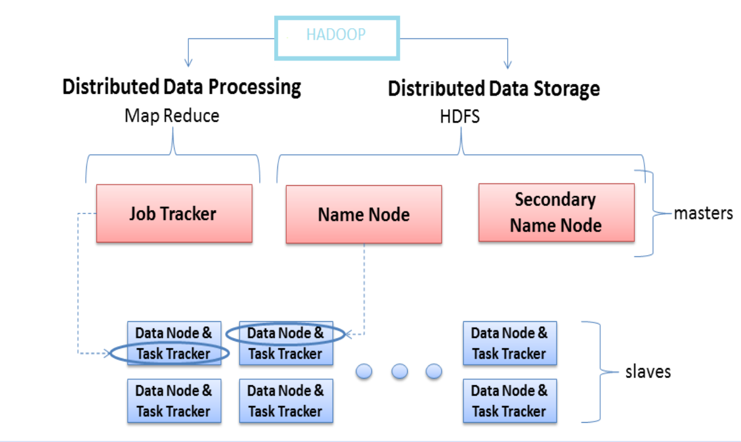
2. Hadoop Server Roles

Slide 14
HDFS (Hadoop Distributed File System)
A distributed file system that provides high-throughput access to application data
HDFS uses a master/slave architecture in which one device (master) termed as NameNode controls one or more other devices (slaves) termed as DataNode.
It breaks Data/Files into small blocks (128 MB each block) and stores on DataNode and each block replicates on other nodes to accomplish fault tolerance.
NameNode keeps the track of blocks written to the DataNode.

Slide 15
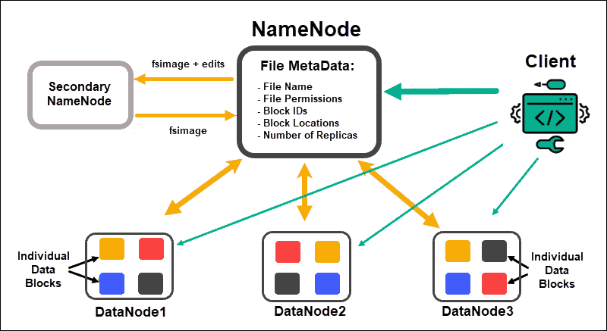
HDFS (Hadoop Distributed File System)
A typical Hadoop cluster installation consists of:
- NameNode
- Secondary NameNode
- Multiple DataNodes

Slide 16
HDFS (Hadoop Distributed File System)
- NameNode
The NameNode is the main point of access of a Hadoop cluster. It is responsible for the bookkeeping of the data partitioned across the DataNodes, manages the whole filesystem metadata, and performs load balancing.
- Secondary (standby) NameNode
Keeps track of changes in the NameNode performing regular snapshots, thus allowing quick startup to guarantee high availability (NameNode is a single point of failure)
- DataNode
Here is where the data is saved and
the computations take place (data
nodes should actually be called "data
and worker nodes")

Slide 17
HDFS- Data Redundancy (for data protection)
Data redundancy: a method to recover the lost data using the redundant data.
In order to prevent data loss and/or task termination due to hardware failures HDFS uses either :
  Replication (creating multiple copies -usually 3- of the data): The simplest method for coding data by making n copies of the data.
    n-fold replication guarantees the availability of data for at most n - 1 failures and it has a storage overhead of 200% (this is equivalent to a storage efficiency of 33%).
  Erasure coding
  The process entails the fragmentation of data into smaller components and the creation of supplementary elements, referred to as parity, which are distributed across multiple storage nodes. The presence of redundancy in the system allows for the retrieval of data fragments that have been lost or corrupted,

Slide 18
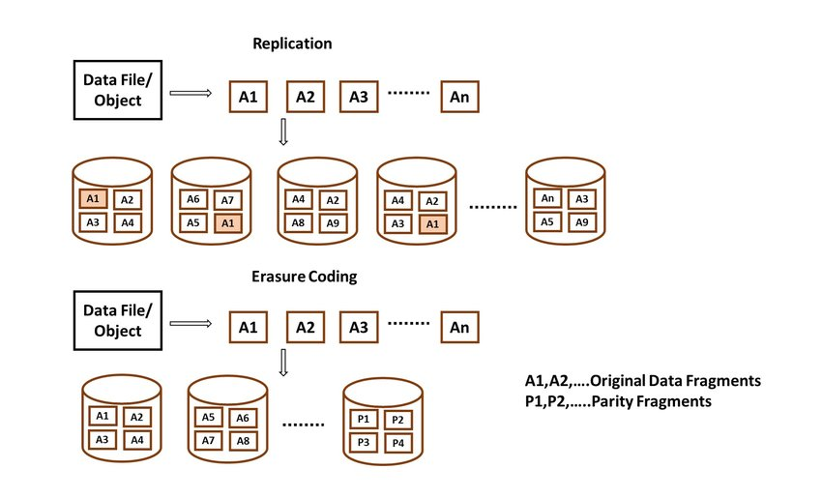
Replication vs. Ensure Coding

Slide 19
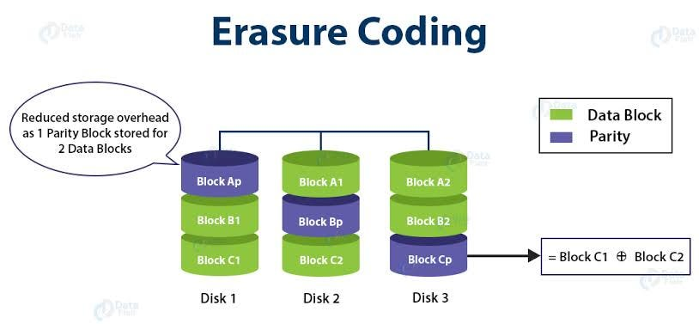
More clarification

Slide 20
HDFS architecture: internal data representation
HDFS supports working with very large files.
Internally, data are split into blocks. One of the reason for splitting data into blocks is that in this way block objects all have the same size.
The block size in HDFS can be configured at installation time and it is by default 128MB.
Note: Hadoop sees data as a bunch of records and it processes multiple files the same way it does with a single file.

Slide 21
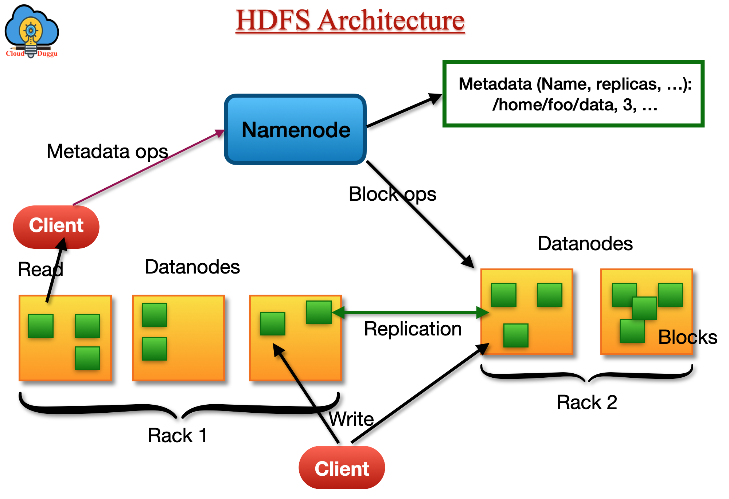

Slide 22
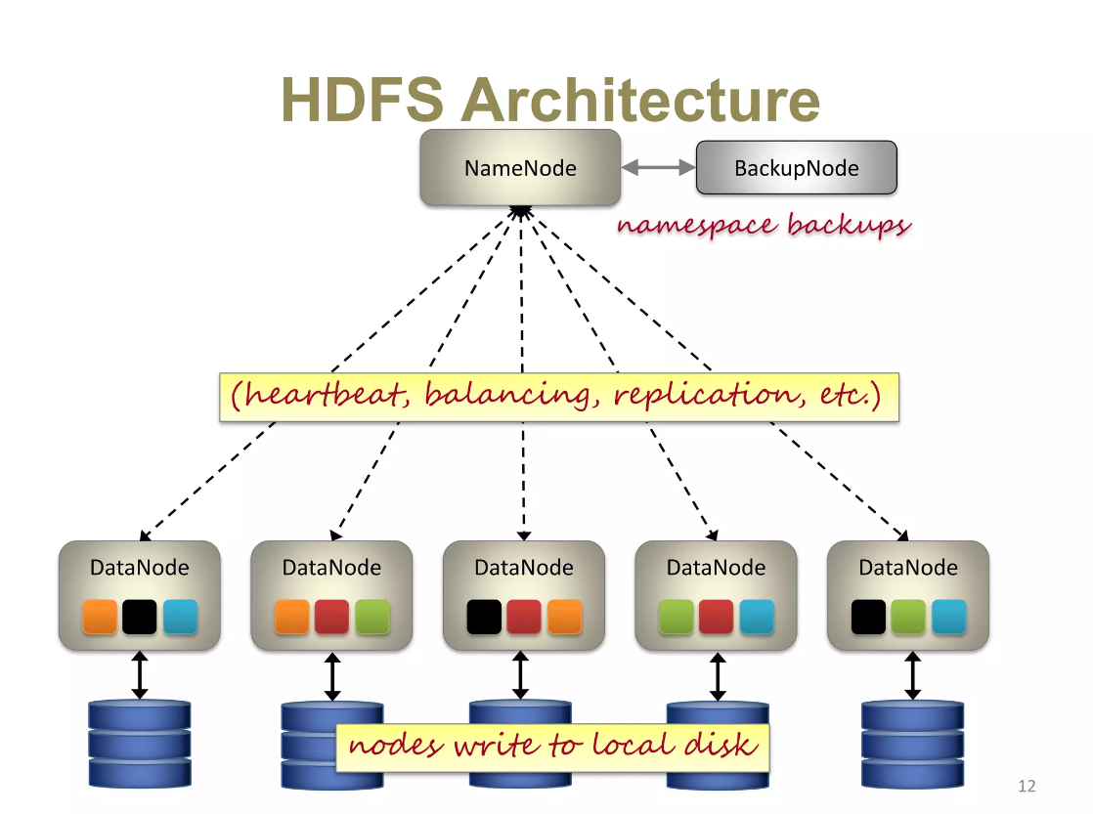

Slide 23
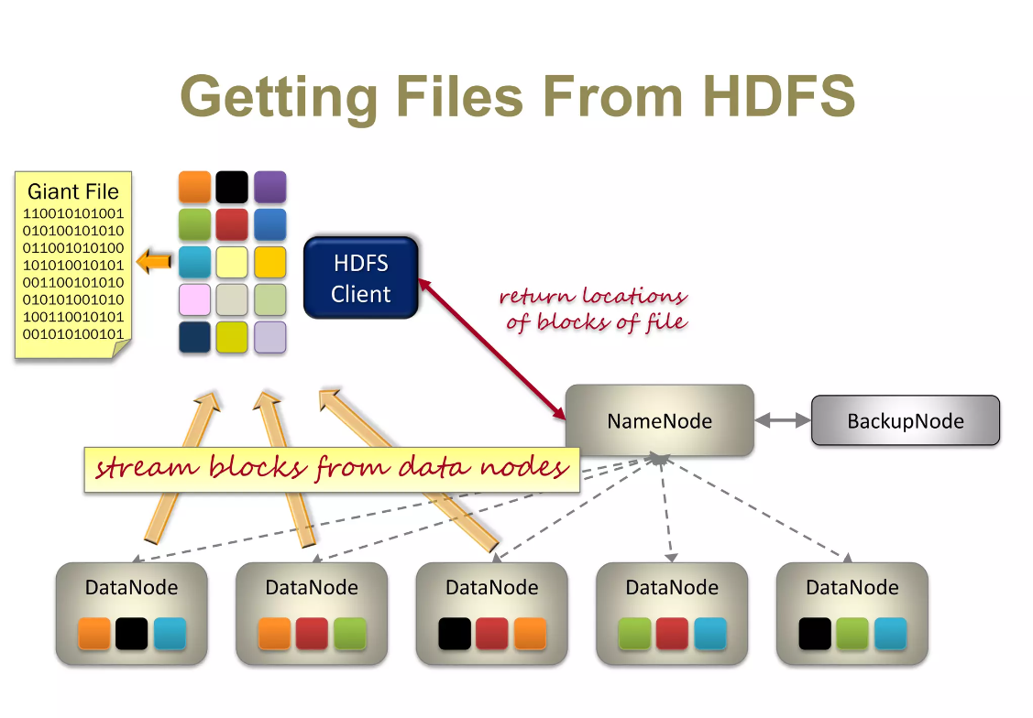

Slide 24
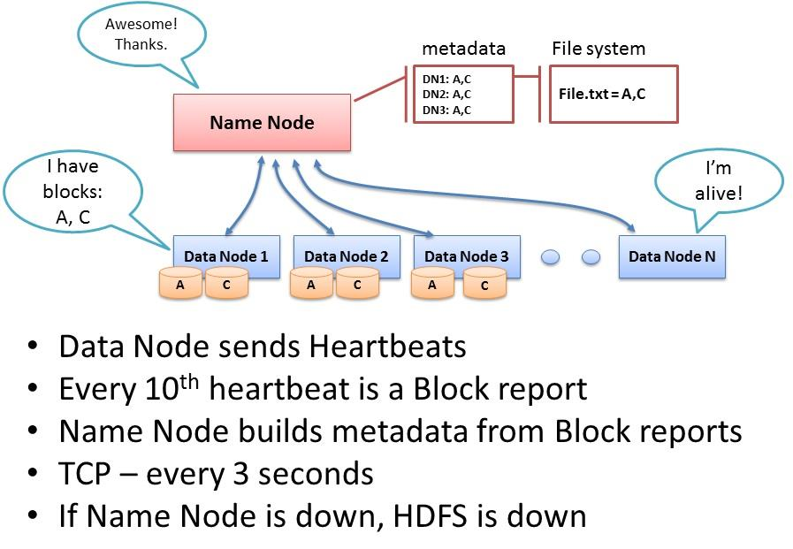

Slide 25
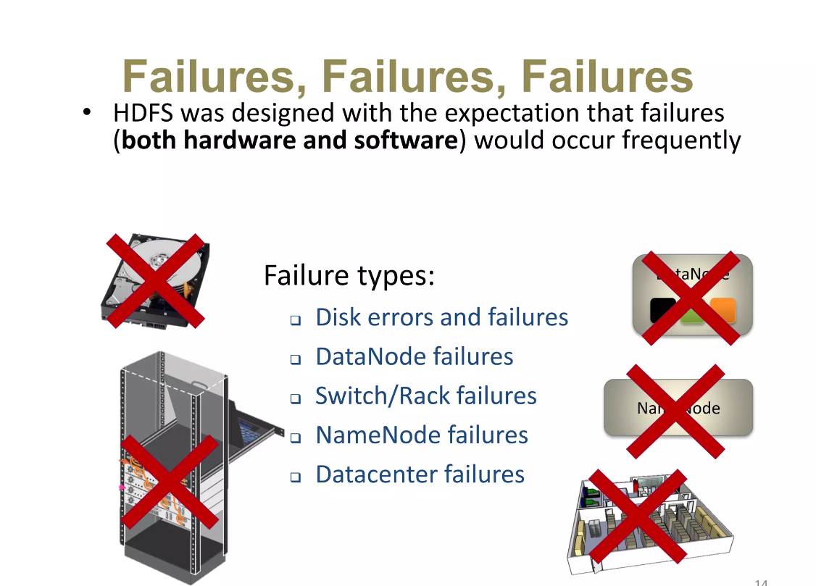

Slide 26
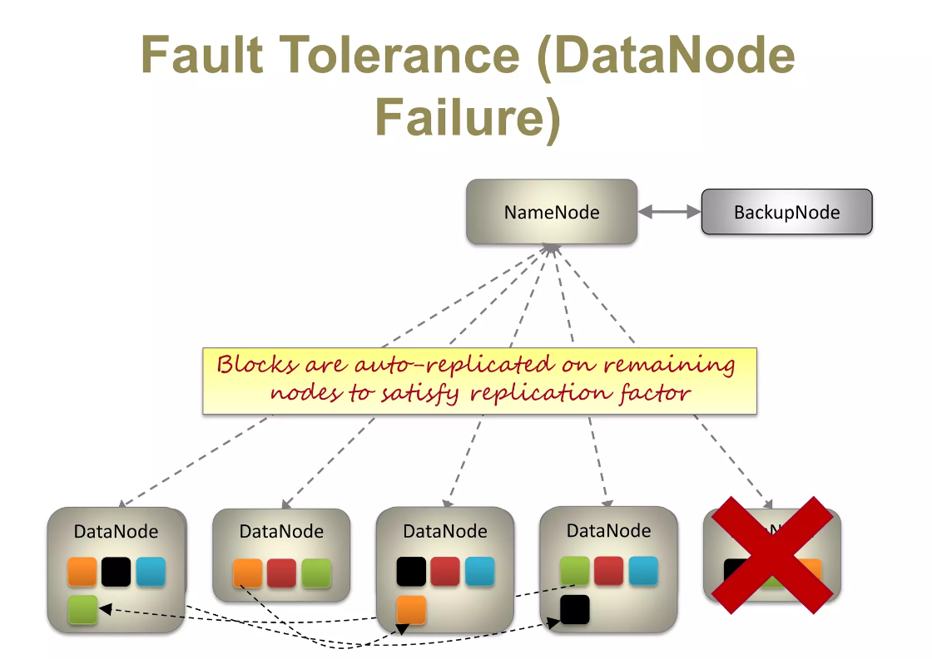

Slide 27
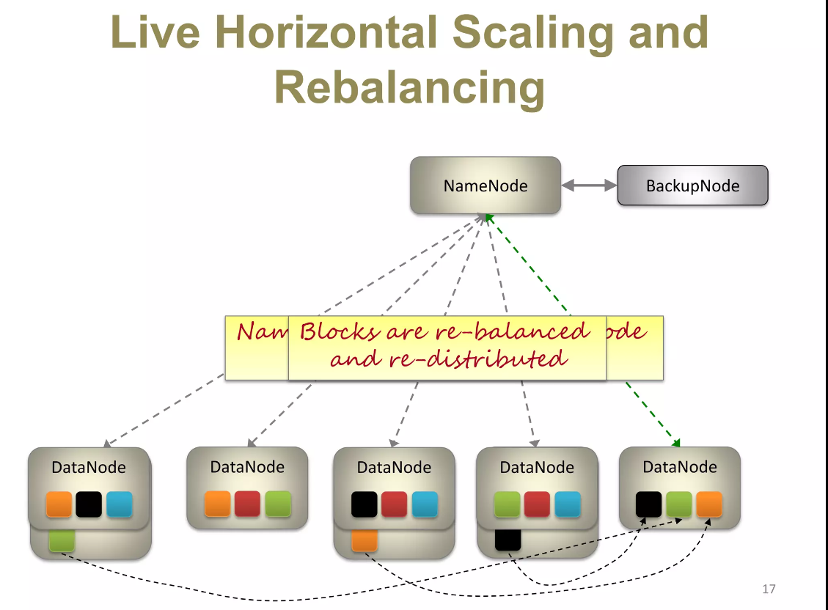

Slide 28
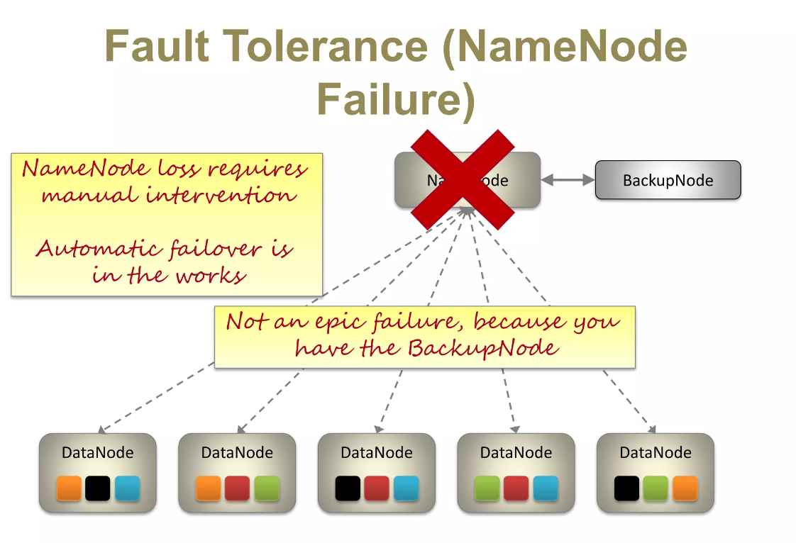

Slide 29
Assignment:
If you have a file of 100 TB required to be stored by HDFS, where this file is divided into blocks of 10 TB each.
Draw how can you store these data, and what are the required number for the data nodes, if each one can store 30 TB.
Note: you have to ensure replication. Also you have 2 racks for data nodes.

